Slide 1
Rapid Tooling -direct and indirect tooling

Slide 2
Direct tooling
Many attempts have been made to develop a new manufacturing technique that would reduce the lead times that has been a huge obstacle in the industry in the past. One approach is called direct tooling and the best example for this would be CNC machining.
With the use of CAD digital file, the direct tooling machine can chip off part from a block in a subtractive process. The newest addition to the direct tooling process is 3D printing, which is an additive process. It builds a 3D shape object by adding the materials layer by layer.
Both processes are frequently used in manufacturing and took less time to produce. These are the pros and cons of using direct rapid tooling:

Slide 3
Direct tooling
Pros
Faster production
It involves fewer steps and resources to make
You can produce multiple prototypes
Flexible
Cons
Less durable
Prone to minor errors
Not suitable for complex designs
Increase in cost

Slide 4
Indirect Tooling methods
The second approach to rapid tooling is indirect tooling where the tool is formed using an intermediate step known as the “master” model. The master is a 3D shape which can be copied multiple times. The process may be retrogressive but it was proven effective. It ensures that the tools are strong and robust for high-volume production.

Slide 5
Indirect Tooling methods
Pros
It makes durable tools
More cost-effective
You can create hard or soft tools depending on your requirement
It produces tools with less discrepancies and variations
You can use it to experiment with different materials
Cons
It is more time-consuming
Entails additional costs
It needs high quality materials to improve its durability
It does not fit simple designs and is more appropriate for complex designs

Slide 6
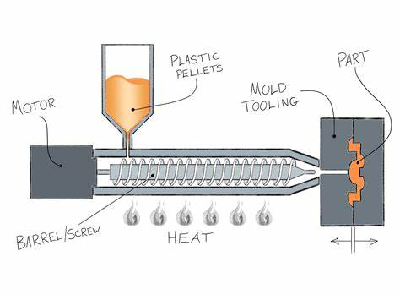
Injection Molding Process

Slide 7
Understanding plastic injection molding process
Plastic injection molding processes consist of four main stages: filling, packing, cooling and stripping. The four stages determine the quality of the injection molded parts, and the four stages are a complete and continuous process.

Slide 8
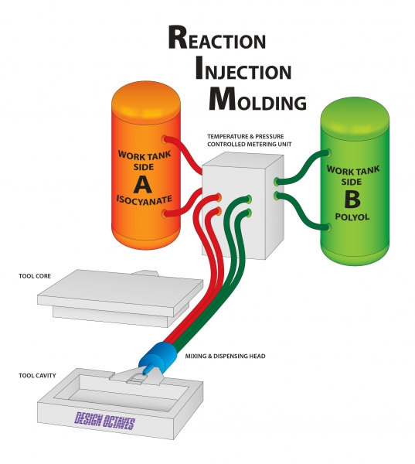

Slide 9
Wax Injection Molding
wax melting pot with a capacity of 50 to 100 liters feeding a plunger injection unit and aluminum tooling.
Since the wax first has to be fully melted in the pot, startups can take 3 to 6 hours.
The wax has to be kept at a constant temperature, so energy consumption is high.
Plunger injection is used, so there is no chance of quickly changing melt temperatures
Better accuracy, versatility, integrity, and finish are potential benefits for the investment casting industry from a breakthrough development in injection molding technology.

Slide 10
Wax Injection Molding
In addition, since a very low viscosity must be achieved to ensure process stability in plunger injection, temperatures must be maintained at the upper limit. That means longer cooling times and slower cycles, not to mention, it typically takes a minimum of one day to change waxes.
Using screw plasticizing is difficult because waxes come in such a wide variety of grades, flow and hardening behaviors, and other performance properties.
In response to these challenges, system was designed with a heated screw and barrel.
Hot water (140F to 158F) is circulated inside the channel, which provides a maximum of 2 minutes residence time in the barrel.
Material changes take only 15 minutes.
Other potential benefits include more design freedom, higher dimensional accuracy and consistency, and less scrap.

Slide 11
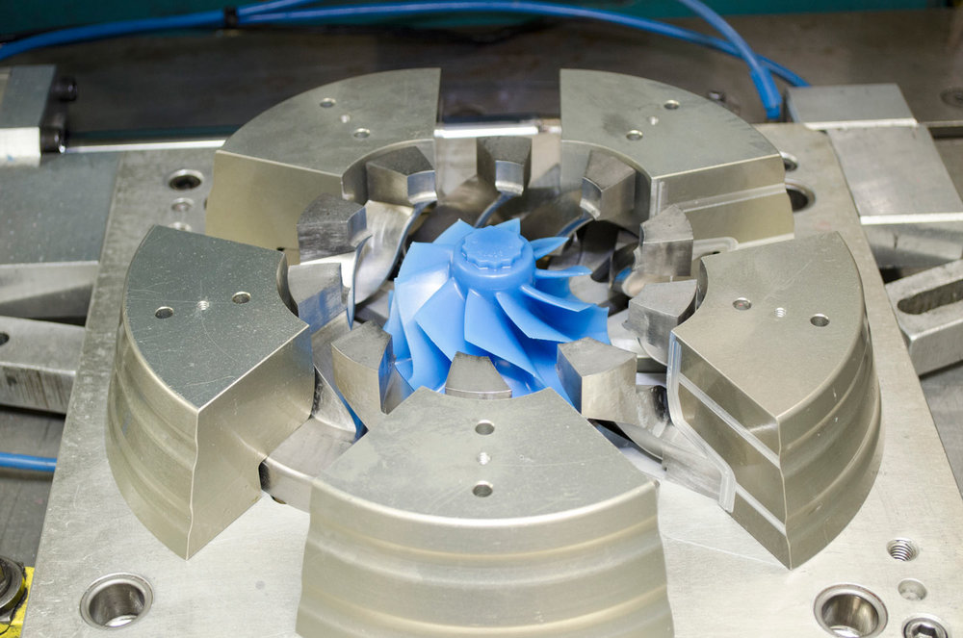
Wax Injection Molding

Slide 12
Indirect rapid tooling methods
Vacuum Casting: Some plastic parts can be vacuum cast by putting one silicone tool in any vacuum chamber by using polyurethane resin. It is mixed and then de-gassed before pouring into the silicone cavity. Later the vacuum gets released, and then the tool gets removed to any post-curing oven toll 2hours based on the size of the device. Then the cavity will be opened, and the polyurethane part will be removed. Then the pit is closed, and the entire procedure is repeated.

Slide 13
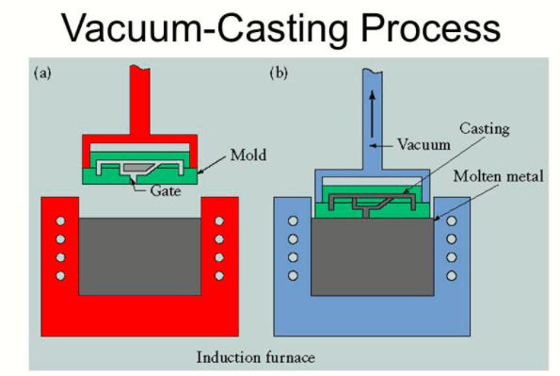
Indirect rapid tooling methods

Slide 14
Indirect rapid tooling methods
Wax injection molding: The silicone cavity is also appropriate for investment casting where waxes are injection molded at low pressure. Please make use of low pressure and injection system, semi-molten wax will be forced within the cavity till it becomes full. Then it is chilled before the wax becomes completely solidified. Then it is entirely removed from the silicone cavity, and the total procedure is repeated. Too much care needs to be provided when you remove wax parts from it due to the weakness of casting wax materials.
Sprayed Steel: Here, the atomized material gets deposited by making use of on spray gun. Many spray heads get involved. This procedure will produce tough tools, and this is a very functional procedure than conventional sprayed steel tooling. The main benefit of this procedure is that this will work great for large tools mostly as steel metal stamping goes away. It will offer a high deposition rate and will be less costly compared to traditionally machined metal tooling. The tool cost, fees of license, and limitations related to spraying into the slots and holes are big disadvantages.

Slide 15
